Slide 1

Minor Project on Stock Market Analysis and Forecasting
Submitted by: Submitted to:
Anish Acharya [21075396] Department of Computer and IT Engineering
Bhuwan Prasad Joshi [21075406] Everest Engineering College
Chetan Babu Bhat [21075409 ] Affiliated to Pokhara University
Pradeept Jarur Shahi [ 21075420 ] Sanepa-2, Lalitpur.
25/09/2024

Slide 2
Contents
Introduction/Background
Statement of Problem
Objective
Literature review
Methodology
Results
References

Slide 3
Introduction/Background
The stock market plays a crucial role in the global economy.
Stock market offers investment opportunities and financial growth for investors.
Predicting stock prices is a complex task due to their highly dynamic and volatile nature.
Machine Learning models, especially deep learning frameworks like LSTM, can process large datasets and identify patterns.

Slide 4
Statement of Problem
Stock market is influenced by various factors:
Political events,
Market sentiment,
Inflation,
Market manipulation, etc.
Traditional approaches often prioritize accuracy but overlook profitability and risk management.
Predicting stock prices demands models capable of handling noise, volatility, and dynamic trends.

Slide 5
Objective
Forecast Nepal’s stock market trends using LSTM model.

Slide 6
Literature review
Deep Learning for Finance: J.B. Heaton et.al [1] explored the use of deep learning in financial predictions. Deep learning models handle complex correlations better than traditional predictors.
ARIMA Model for Stock Prices: Mondal et.al [2] evaluated the effectiveness of ARIMA for stock price prediction. ARIMA provides reasonable accuracy but is less effective compared to advanced models like LSTM
LSTM and BiLSTM for Time-Series Forecasting: Sima Siami-Namini [3] demonstrated that LSTM significantly outperforms ARIMA. LSTM achieves 84%-87% better accuracy due to its ability to learn from sequential data.
Hybrid models (CNN, RNN): Hiransha [4] showed hybrid architectures can outperform standalone models. Combining methods like RNN and CNN improves trend detection and prediction accuracy

Slide 7
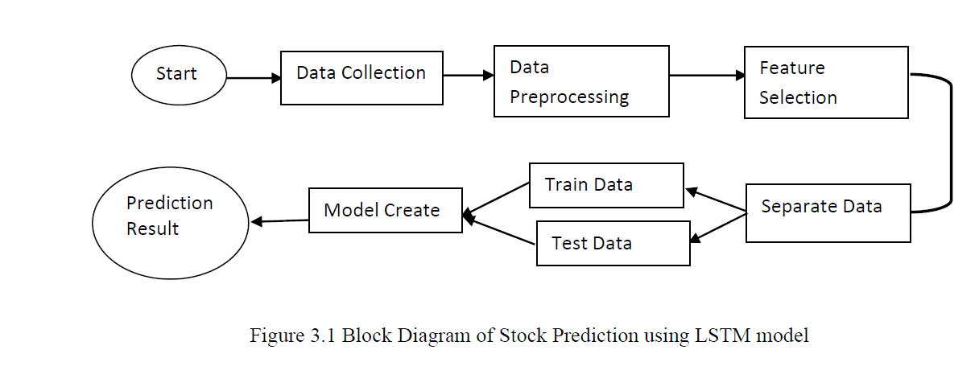
Methodology
Collect historical stock price data.
Preprocess data for training and testing.
Train a LSTM model to predict future prices.
Data Collection and Preprocessing
Data source: ShareSansar (10+ years of historical data).
Filer data to include closing prices only.
Normalize data using MinMaxScaler.
Split data into training (80%) and testing (20%).
Create 60-day sequences for LSTM input.

Slide 8
Algorithm
Why Long Short-Term Memory (LSTM)?
It is specifically designed for time-series data, making it ideal for stock price prediction.
It can effectively capture long-term dependencies and patterns in sequential data such as stock market data.
It can easily handle noisy and volatile data which is very common in stock market datasets.

Slide 9
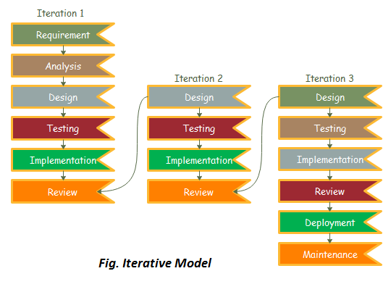
System Development Life Cycle
Iterative Model
Why?
Phased Approach
Feedback Loops
Risk Management
Flexibility

Slide 10
Tools used:
Programming Laguage: Python
Libraries: TensorFlow, Pandas, NumPy, Scikit-learn
Development: Jupyter Notebook, Google Collab

Slide 11
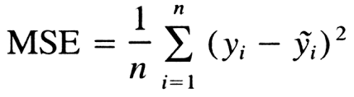
Evaluation/Testing
Mean Squared Error (MSE):
MSE measures the average of the squared differences between the predicted and actual values.
Goal: Minimize the MSE to improve the accuracy of predictions.
Interpretation: Lower MSE indicates better model performance.

Slide 12
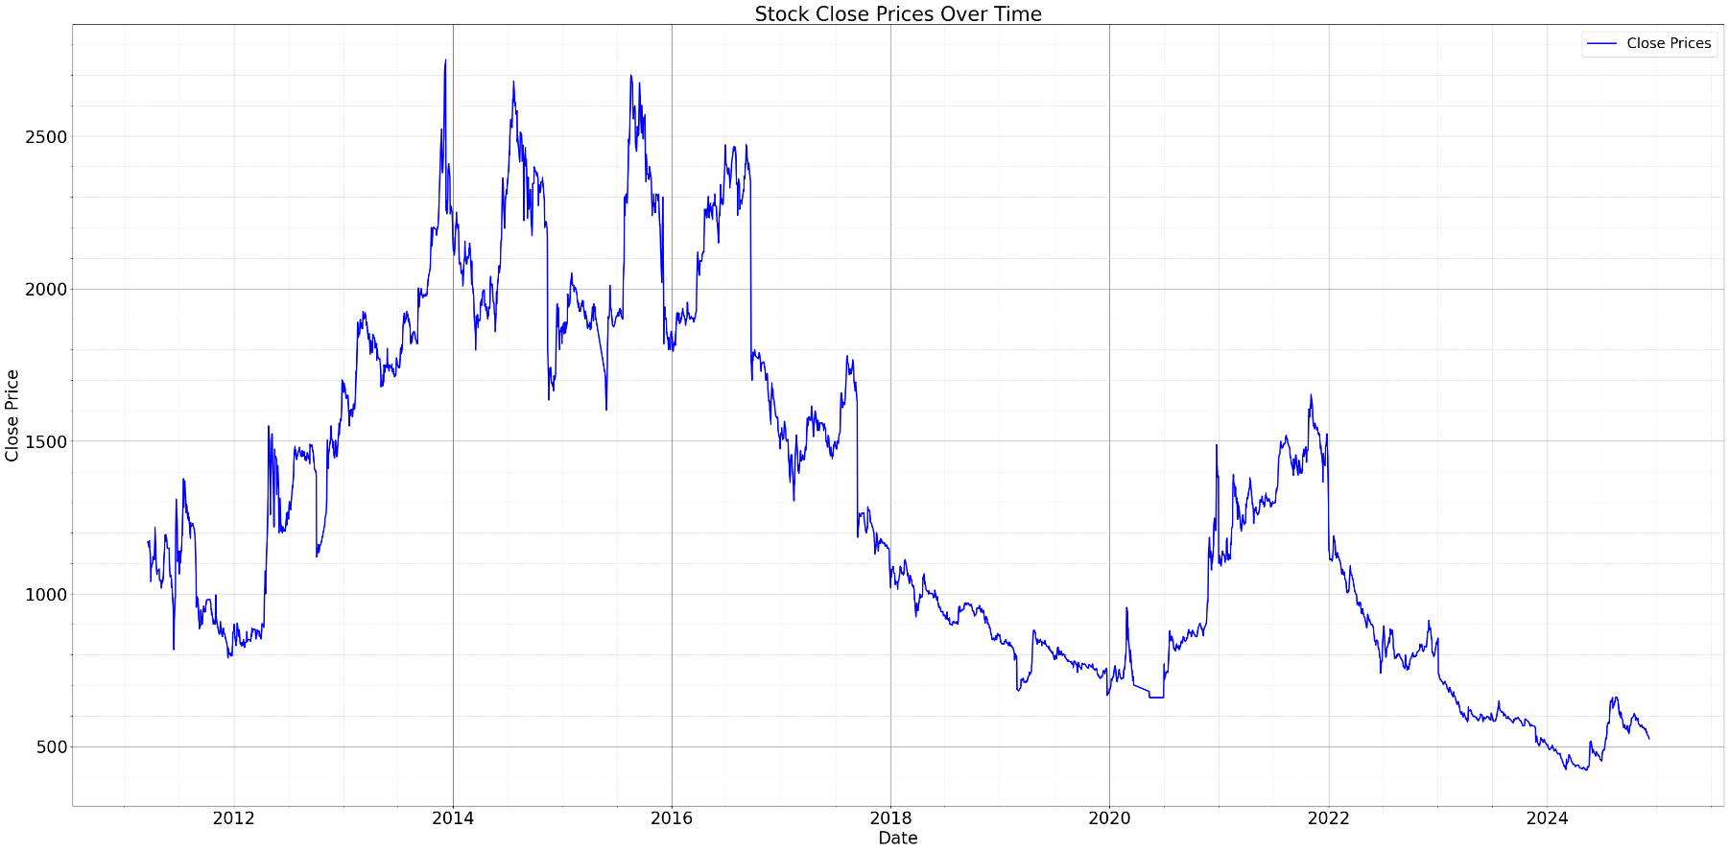
Work completed
Data collection and preprocessing.
Developed an LSTM model with stacked layers and dropout for regularization.
Trained the model with historical stock data.

Slide 13
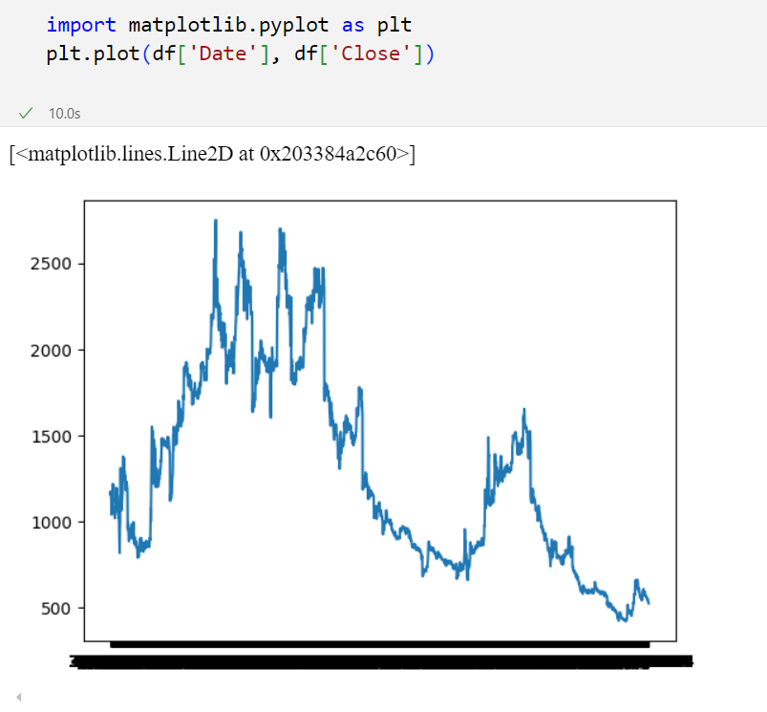
Challenges Faced:
Resolved graph axis issues by converting data types.
Fig: Problem 1

Slide 14
Work Remaining
Predict and test data and plot the output.
Forecast the data of 30 days in the future and plot the output.

Slide 15
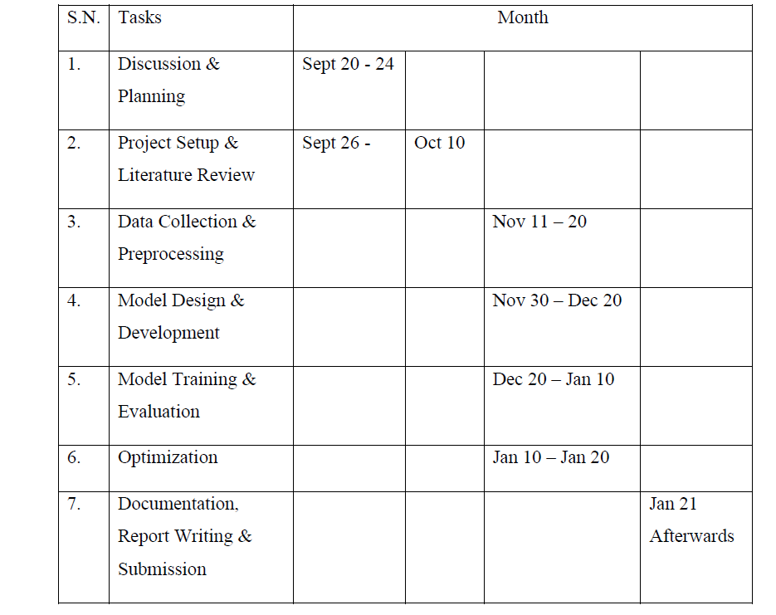
Schedule

Slide 16
References
[1] “Heaton J.B., Polson N.G., Witte J.H. Deep learning for finance: deep portfolios”
Applied Stochastic Models in Business and Industry, 33 (1) (2017), pp. 3-12
https://scholar.google.com/scholar_lookup?title=Deep%20learning%20for%20finance%3A%20deep%20portfolios&publication_year=2017&author=J.B.%20Heaton&author=N.G.%20Polson&author=J.H.%20Witte
[2] Mondal, Prapanna & Shit, Labani & Goswami, Saptarsi. (2014). “Study of Effectiveness of Time Series Modeling (Arima) in Forecasting Stock Prices”. International Journal of Computer Science, Engineering and Applications. 4. 13-29.http://dx.doi.org/10.5121/ijcsea.2014.4202
[3] Siami Namini, Sima & Siami Namin, Akbar. (2018). “Forecasting Economics and Financial Time Series: ARIMA vs. LSTM”.
https://doi.org/10.1109/BigData47090.2019.9005997
[4] Hiransha M, Gopalakrishnan E.A., Vijay Krishna Menon, Soman K.P.,NSE “Stock Market Prediction Using Deep-Learning Models, Procedia Computer Science”, Volume 132, 2018, Pages 1351-1362, ISSN 1877-0509,
https://doi.org/10.1016/j.procs.2018.05.050

